Slide 1
Advanced Thread Synchronization for Multithreaded MPI Implementations
Hoang-Vu Dang⁺, Sangmin Seo*, Halim Amer*, Pavan Balaji*
Acknowledgement: Marc Snir⁺
⁺University of Illinois at Urbana-Champaign (UIUC)
*Argonne National Laboratory

Slide 2
Overview
Motivation
Analysis and Approach
Evaluation
Conclusion

Slide 3
Motivation
Hybrid programming (MPI+X)
MPI for communications
Other abstractions for heterogeneity, multithreading, multitasking, data flow..
Ability to communicate from every thread
Extending programming capability
MPI_THREAD_MULTIPLE limited performance
[1]
[1] Knights landing (KNL): 2nd Generation Intel Xeon Phi processor, HOTCHIP 2015

Slide 4
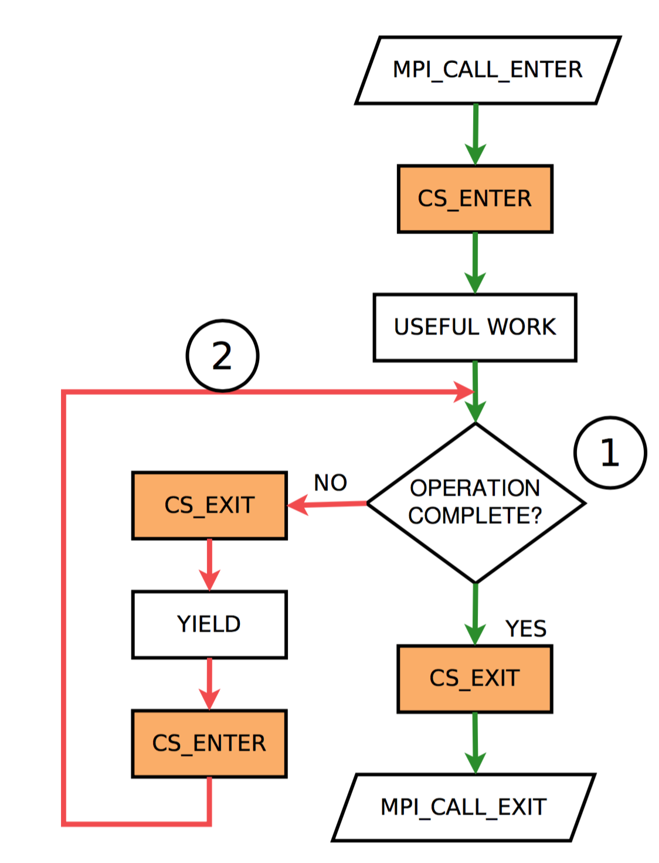
MPI_THREAD_MULTIPLE implementations
Single Critical Section (CS)
Two path to enter CS:
From the Entry Function
From inside the Progress Engine
Idea: choosing a useful thread to enter the CS.
LOCK_HIGH
LOCK_LOW

Slide 5
Related research
MPI + User-Level Threads:
[Lu-15], [Dang-16]:
Yielding is cheaper in ULT
Schedule a ULT according to communication state
MPI + Kernel threads (no oversubscription)
[Amer-15]
FIFO and prioritized Locks (CLH, P-CLH)
This works
[Lu-15] MPI+ULT: Overlapping Communication and Computation with User-Level Threads.
[Amer-15] MPI+Threads: Runtime contention and remedies .
[Dang-16] Towards millions of communicating threads.
Notes:
- Faster lock hide the kernel scheduler in POSIX mutex lock
- Circulate the CS to different thread so each has chance to progress

Slide 6
Performance Benchmarks
Latency
Bandwidth & Message Rate
If (rank == 0)
for (i=0;i<WORK;i++)
{
MPI_Send(.., 1, i,…)
MPI_Recv(…, 1, i,...)
}
If (rank == 1)
#pragma omp parallel
for (i=td;i<WORK;i+=nt) {
MPI_Recv(…, 0, i...)
MPI_Send(…, 0, i...)
}
If (rank == 0)
#pragma omp parallel
for (i=tid;i<WORK;i+=nt)
{
for (j=0;j<WIN;j++)
MPI_Isend(.., 1,…)
MPI_Waitall(WIN..)
MPI_Recv(..1..)
}
If (rank == 1)
#pragma omp parallel
for (i=td;i<WORK;i+=nt)
{
for (j=0;j<WIN;j++)
MPI_Irecv(.., 0,…)
MPI_Waitall(WIN..)
MPI_Send(..0..)
}
Ideally, performance must remain similar to single-threaded program

Slide 7
Experiment Platform
Benchmarks:
Haswell-EP E5-2699v3:
36 cores in 4 NUMA nodes
FDR Mellanox
MPICH 3.2
Intel Compiler 16.0.3 (-O3)
MXM HPCX 1.6.392
Application:
Xeon E5 processors
16 cores in 2 NUMA nodes
FDR Mellanox
MPICH 3.2
Intel Compiler 15.0.2 (-O3)
MXM HPCX 1.6.392

Slide 8
Initial performance
Performance degrades for all benchmarks
FIFO locks (P-CLH, CLH) improves over Pthread mutex (MTX) in most cases
None comes close to ideal

Slide 9
Latency issues: wasted time in critical section
FIFO locks and prioritization has much waste in the critical section

Slide 10
What happens ?
Rank 0 (single-thread)
Rank 1 (N threads)
Send to rank 1, tag 0
Recv from rank 1
…
...
...
...
...
...
...
...
...
...
Done
Send to rank 1, tag 1
...
T₀ Enter CS
Post recv tag 0, POLL, yield
…
T_{k} Enter CS
Post recv tag k, POLL
finish tag 0 request
POLL, yield
T_{k’} Enter CS
Post recv tag k’, POLL, yield
...
T₀ Enter CS
His request is finished.
Performs a SEND reply.
delayed O(N)
Notes:
Assuming a random arbitration

Slide 11
Solution: Work-driven activation
Idea:
For each completed request, gives a chance to waiting threads to enter CS.
Threads with no work must not fight for CS.
Challenge for MPI implementations
No centralized thread scheduler
No centralized poller
→ *decentralized strategy* needed

Slide 12
Solution: Work-driven activation
First thread becomes the “server”, keep entering the CS.
Other threads becomes “waiter” waiting for signal.
T₀
T₁
T₂
T_{k}
S
W
W
W

Slide 13
Solution: Work-driven activation
First thread becomes the “server”, keep entering the CS.
Other threads becomes “waiter” waiting for signal.
T₀
T₁
T₂
T_{k}
S
W
W
C₁
W
C

Slide 14
Solution: Work-driven activation
When the server is done, it elects a “waiter” to become “server” by signaling it
O(N) -> O(1) delay
T₀
T₁
T₂
T_{k}
S
W
W
C₁
W
C
C
E
S

Slide 15
Implementation: User-Level Condition Signal (UCS)
Associate a request(s) to a waiting thread using pointer to a flag.
Signal == bit-flip
Maintain a list of waiter
When requests associated with the thread are completed:
Thread received a ”signal”
Is removed from waiters
NO
WAITER?
YES
SIGNAL
wait
RECV SIGNAL
SIGNAL

Slide 16
Result: Latency
3x
At 36 threads:
FIFO locks: 11.3 usec
With new technique : 3.3 usec
At 36 threads:
FIFO locks:
SYNC 3.6 usec, EMPTY CS 5.8 usec
With new technique:
SYNC 0.9 usec EMPTY CS 0.65 usec

Slide 17
Bandwidth and Message Rate
New technique improves for bandwidth, but not much for message rate, since in message rate benchmark, there is no wasted (grey), mostly issue (blue)

Slide 18
What happens ?
Lock inside MPI_ISEND and MPI_IRECV causes a “hotspot”
CS is moving between cores and NUMA nodes:
Higher synchronization/scheduling overheads
Higher cache misses
If (rank == 0)
#pragma omp parallel
for (i=tid;i<WORK;i+=nt)
{
for (j=0;j<WIN;j++)
MPI_Isend(.., 1,…)
MPI_Waitall(WIN..)
}
If (rank == 1)
#pragma omp parallel
for (i=td;i<WORK;i+=nt) {
for (j=0;j<WIN;j++)
MPI_Irecv(.., 1,…)
MPI_Waitall(WIN..)
}

Slide 19
Solution: Bias synchronization
Allow scheduling bias for the thread most recently executed.
Allow scheduling bias towards thread within the same NUMA node.
Giving fairness when there is no hotspot.
Challenge: how to do all this without centralize scheduler, and with low-overhead ?
← A thread keeps issuing all of its own requests.
When a thread is finished, it chooses the closest thread to pass the CS.
Prevent deadlocks inside the progress engine

Slide 20
Unbounded Bias Lock (CLHub)
LOCK_HIGH(L)
IF TRY_ACQUIRE (L->bias) == FAIL:
ACQUIRE(L->fifo_high)
L->filter = 1
ACQUIRE(L->bias)
L->filter = 0
RELEASE(L->fifo_high)
UNLOCK_HIGH(L)
RELEASE(L->bias)
LOCK_LOW(L)
ACQUIRE (L->fifo_low)
While (L->filter == 1);
ACQUIRE (L->bias);
RELEASE(L->fifo_low)
UNLOCK_LOW(L)
RELEASE(L->bias)
bias
fifo_high
T0
T1
T2
T3
fifo_low
T4
T5

Slide 21
Result: Message rate
4x
At 36 threads:
Baseline: 500k msg/s
New results: 2M msg/s
Still losing a bit due to locality and synchronization 0.3 -> 0.4 usec (future work!)

Slide 22
Application benchmark
Communication bound: Graph500
BFS with scale-free graphs (rmat)
Often used to evaluate communication
Expectation: improve performance
Compute bound: HPCCG
Approximate the finite element applications
Core kernel: Sparse Matrix Vector multiply
Expectation: may improve, not degrade

Slide 23
Graph500
Weak scaling
(rmat30 at 4096 cores)
Using 16 cores/threads per node
2x improvement on average.

Slide 24
HPCCG
Core kernel is Sparse matrix vector multiply.
Using 16 cores/threads per node.
3-5% improvement on average.
But is not significant when scaling larger since compute and memory bounded.

Slide 25
Conclusion
Analyzed the performance issue of MPI & Threads using micro-benchmarks
Proposed and evaluated 2 methods:
Work-driven activation: improve blocking calls
Unbounded biased lock: improve non-blocking calls
2-4x improvement for communication bounded application, no degradation for computation/memory bounded application.
Future work: More locality and application analysis

Slide 26
Thank you for you attention
Contact: hdang8@illinois.edu
Question please ?!

Slide 27
Backup Slide – Cache misses

